Slide 1


Kiet group of institutions, gaziabad (An ISO – 9001: 2008 Certified & ‘A+’ Grade accredited Institution by NAAC) Threat Detection and Neutrilization
Guide name : Mr. sreesh gaur
Project Members roll no sec
Shikhar Raj 2000290120144 c
Shubhi 2000290120160 c
Abhijeet Kannaujia 2000290120007 a

Slide 2
Problem statement
The current monitoring systems may have the following limitations or problems:
Inadequate security measures that may lead to unauthorized access and usage of the victim resources.
Lack of real-time monitoring and control, making it difficult to track and stop malicious activity.
Insufficient ability to control remote computers, making it difficult to respond to security threats.
Our project aims to address these limitations and provide a comprehensive solution that offers improved real-time monitoring and control, and the ability to access the severity of the intrusion.

Slide 3
Objectives
A comprehensive monitoring system:
Improved security: Incorporate the latest security measures to prevent unauthorized access and ensure the confidentiality of files.
Real-Time Monitoring: Use real-time monitoring technology to track and control the usage of files in real-time.

Slide 4
Technology used
Machine-Learning Algorithms: Naiive bayes classifer Decision tree, Random forest
Firebase , HTML , CSS , JavaScript

Slide 5
Literature Survey

Slide 6
Detection of Phishing Attacks with Machine Learning Techniques in Cognitive Security Architecture Authors: Ivan Ortiz-Garc ´ es´ ∗, Roberto O. Andrade†, and Mar´ıa Cazares‡
Summary: Technology let us develop better applications. Some phishing techniques like shortening URLs could be faced with tools like this machine learning application that is capable to determinate if a URL are good or bad, next step after that is add this URL to blacklist. Although this machine learning couldn’t be right always we can check those URLs into a web checker of shortnening URLs. Which bring us to next recommendation.
Year of publishing:2019 International Conference on Computational Science and Computational Intelligence (CSCI)

Slide 7
Learning Environment Containerization of Machine Leaning for Cybersecurity Authors: Hossain Shahriar, Kai Qian, Hao Zhang
Summary: The overall goal of this work is to provide containerized packaging to enable students to avoid the hassle of downloading libraries and building environments, to address the needs and challenges of ML capacity building in terms of cybersecurity, as well as the lack of teaching materials and real-world practical learning environments. This project can help students quickly understand what should be considered based on the use of ML for cybersecurity issues in a unique way so that students can learn from cases of vulnerabilities. The modules have been used in some related computer science classes and get positive feedback.
Year of Publishing: 2020 IEEE 44th Annual Computers, Software, and Applications Conference (COMPSAC)

Slide 8
Adaptive Machine learning: A Framework for Active Malware Detection Authors: 1st Muhammad Aslam
Summary: This research paper proposed an adaptive machine learning framework that consolidates the fact that our freeloading machine learning technique significantly improves accuracy in detecting phishing attacks. Our multilayered approach utilizes the K-Nearest Neighbor (K-NN), Random forest (RF), and Support Vector Machine (SVM) algorithms at the first layer. The first layer’s output acts as input for the second layer, where the practical ensemble voting classifier approach boosts the standard classification models. s the machine learning model’s performance and enhances the capability of learning by feeding the result to the data repository for later used for training the model. We have utilized four different network traffic data datasets to deal with the dynamic nature of phishing attacks. The proposed system obtained a proficient results-based analysis of performance metrics that detects the malware’s utmost precision of 96.1%, Recall of 97.79%, and F-measure of 96.59%. Decision-maker model of EV archives the 97.6% accuracy mean and 96.42% prediction accuracy for detecting phishing attacks.
Year of Publishing:2020 16th International Conference on Mobility, Sensing and Networking (MSN)

Slide 9
AI in Cybersecurity Education- A Systematic Literature Review of Studies on Cybersecurity MOOCs Authors: Samuli Laato, Ali Farooq, Henri Tenhunen
Summary: Investigated how the application of AI has been taught in cybersecurity MOOCs and what design philosophies exist by systematically reviewing existing peer-reviewed studies. The results showed that there are surprisingly few studies concerning cybersecurity MOOCs compared to the amount of courses currently offered. Furthermore, all courses, which were discussed in the papers, were organised based on their topic, and none based on the applied method (such as AI). This can be limiting for students looking to specifically learn about how AI is used in the domain of cybersecurity. Finally, only a couple of courses mentioned AI in their course content. These challenges have been addressed by previous work by suggesting that the industry would work together with academia to update course materials to include AI. Altogether, the rapid increase in the popularity of ML applications does not yet show in studies on cybersecurity MOOCs. Updates on existing courses are required to ensure learners receive up to date information on the impact of AI on cybersecurity. New courses could look into organising content based on which applications of AI are most relevant for cybersecurity.
Year Of Publishing:2020 IEEE 20th International Conference on Advanced Learning Technologies (ICALT)

Slide 10
TROJAN TRAFFIC DETECTION BASED ON MACHINE LEARNING Authors: MA ZHONGRUI1 , HUANG YUANYUAN1 , LU JIAZHONG1
Summary: By comparing the various data in the above statistical graphs, we can see that the performance of the three different models established by the Naive Bayesian algorithm for the three types of Trojan traffic is relatively lower than that of the other two machine learning algorithms. In terms of the fluctuation of values, the fluctuation of the relevant values of each model of the Decision Tree algorithm is relatively small, and the performance is relatively stable. However, from all aspects, the evaluation accuracy and precision of the model trained by the Random Forest algorithm are higher than the other two machine learning algorithms, and it can also be seen from the evaluation of each model performed by the F1- Score value that the Random Forest algorithm Compared with the other two machine learning algorithms, the Random Forest algorithm has a better model detection effect. Compared with the other two machine learning algorithms, the model of the Random Forest algorithm is composed of a large number of base learners. The cooperation of different base learners makes the algorithm have better classification capabilities. It can be understood that the model based on the Random Forest algorithm has better performance for Trojan traffic detection than the other two machine learning algorithms, and is more suitable for the detection of Trojan traffic data.
Year of Publishing: June 14,2021 at 18:30:33 UTC from IEEE Xplore.

Slide 11
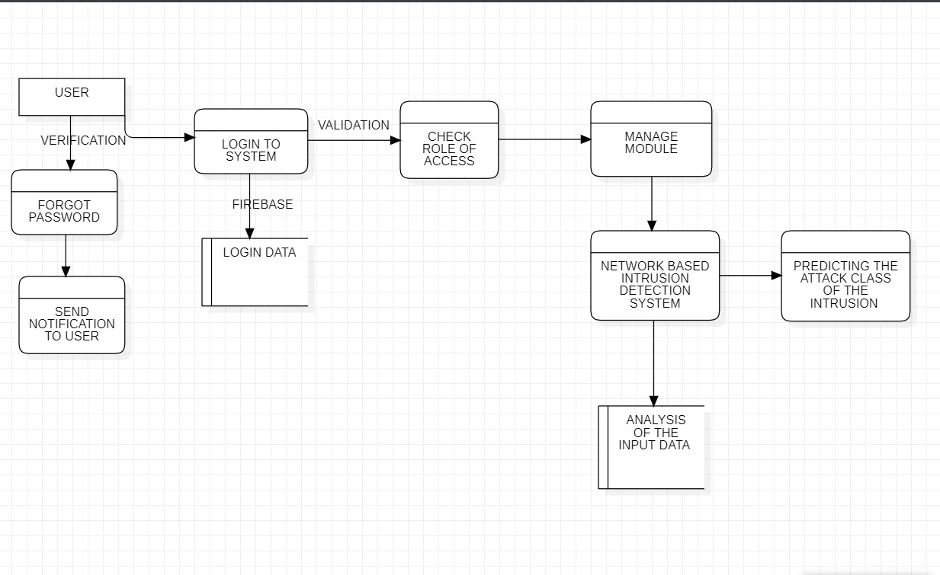
Data-FLOW DIAGRAM

Slide 12

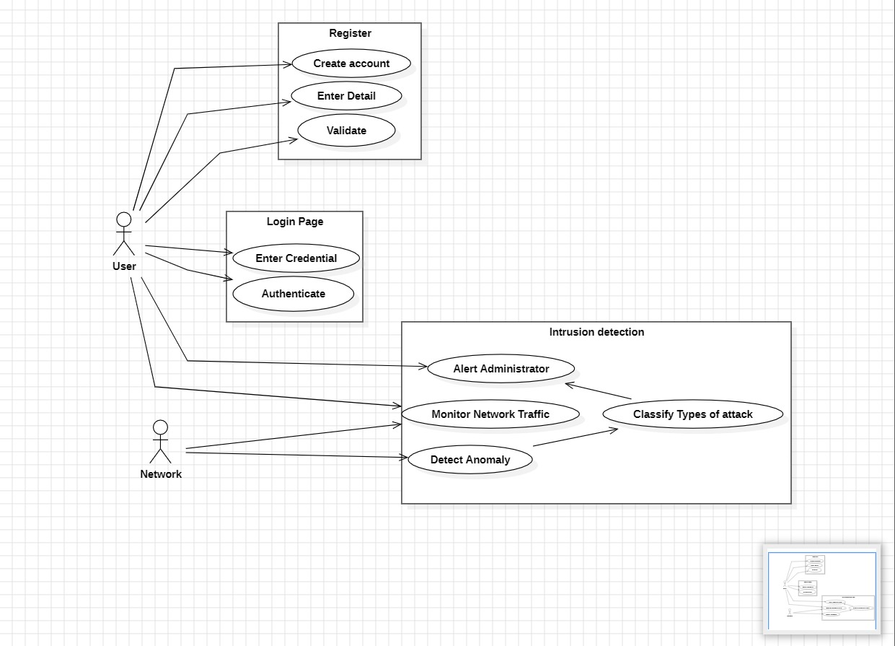

Slide 13

Project Status
Login page

Slide 14
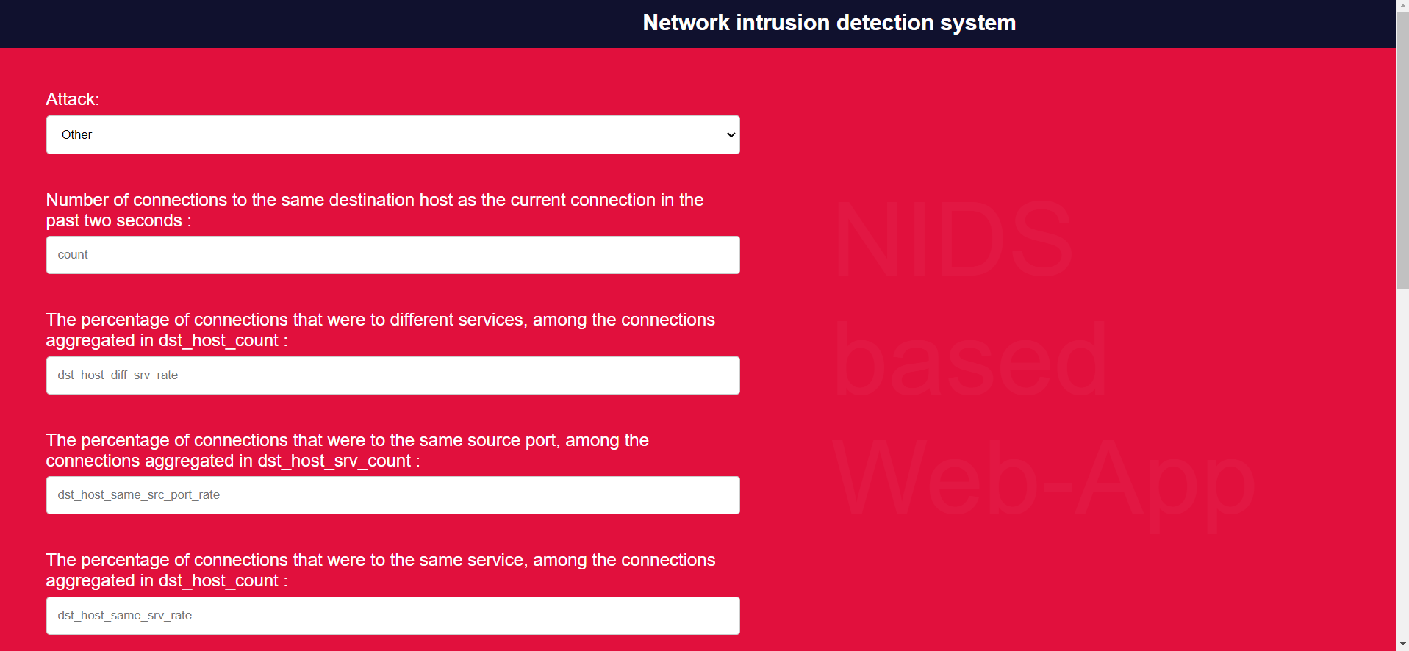
Network intrusion detection System

Slide 15

Screenshot 2

Slide 16
Thank you

